Slide 1
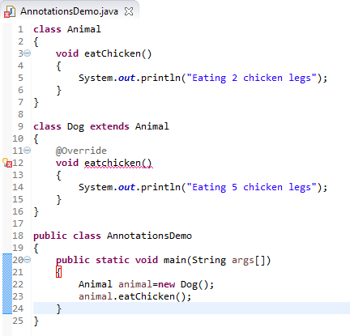

Built-In Annotations in java - @Override
@Override annotation assures that the subclass method is overriding the parent class method. If it is not so, compile time error occurs.
Sometimes, we does the silly mistake such as spelling mistakes etc. So, it is better to mark @Override annotation that provides confirmation that method is overridden.
Should be eatChicken()

